Slide 1
gdT Repertoire Analysis
09/05/2015
Herman Gudjonson

Slide 2
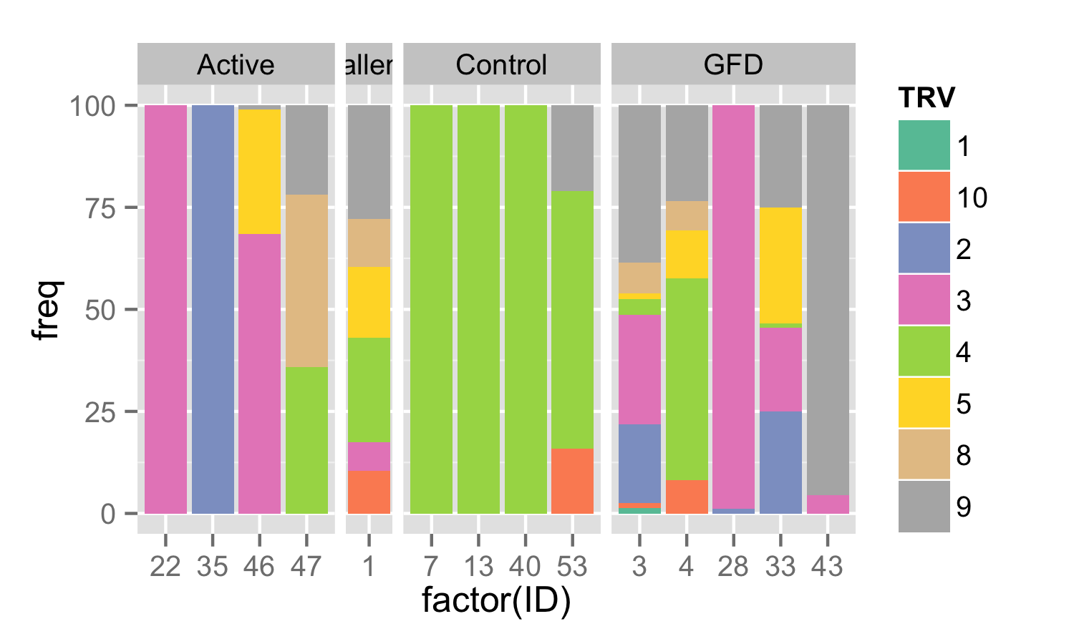
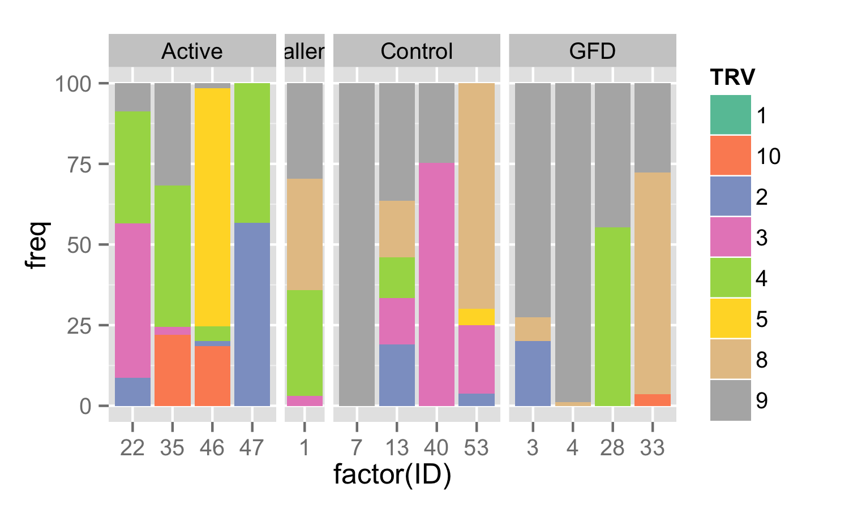
V region representation
IEL
PBL

Slide 3
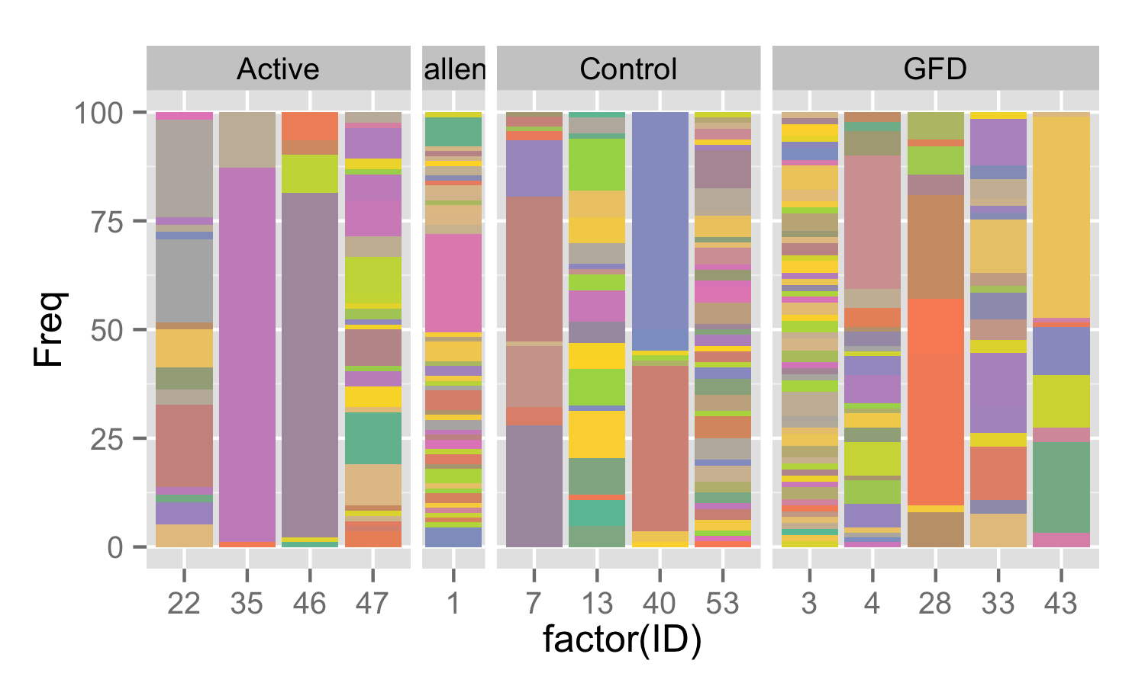
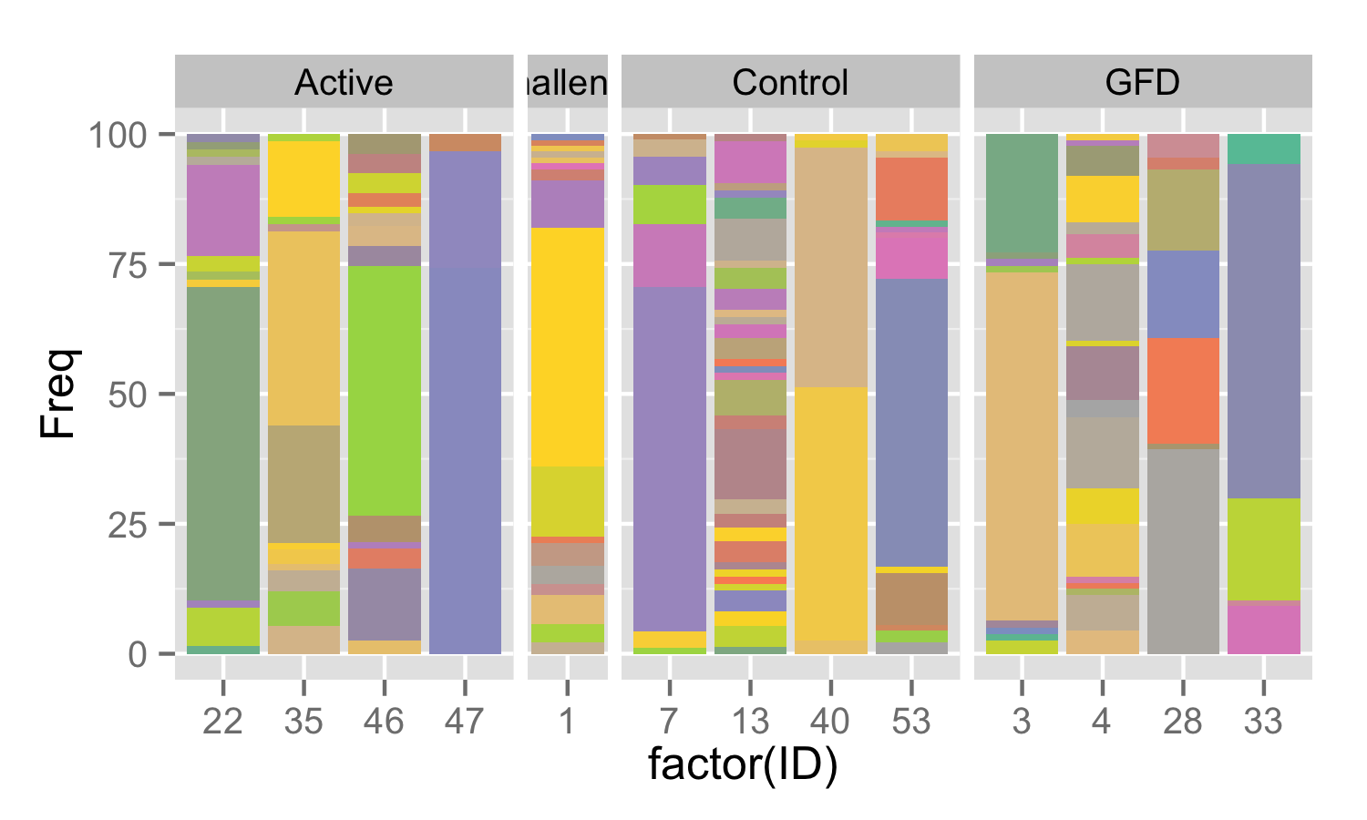
TRD clonal representation
IEL
PBL

Slide 4
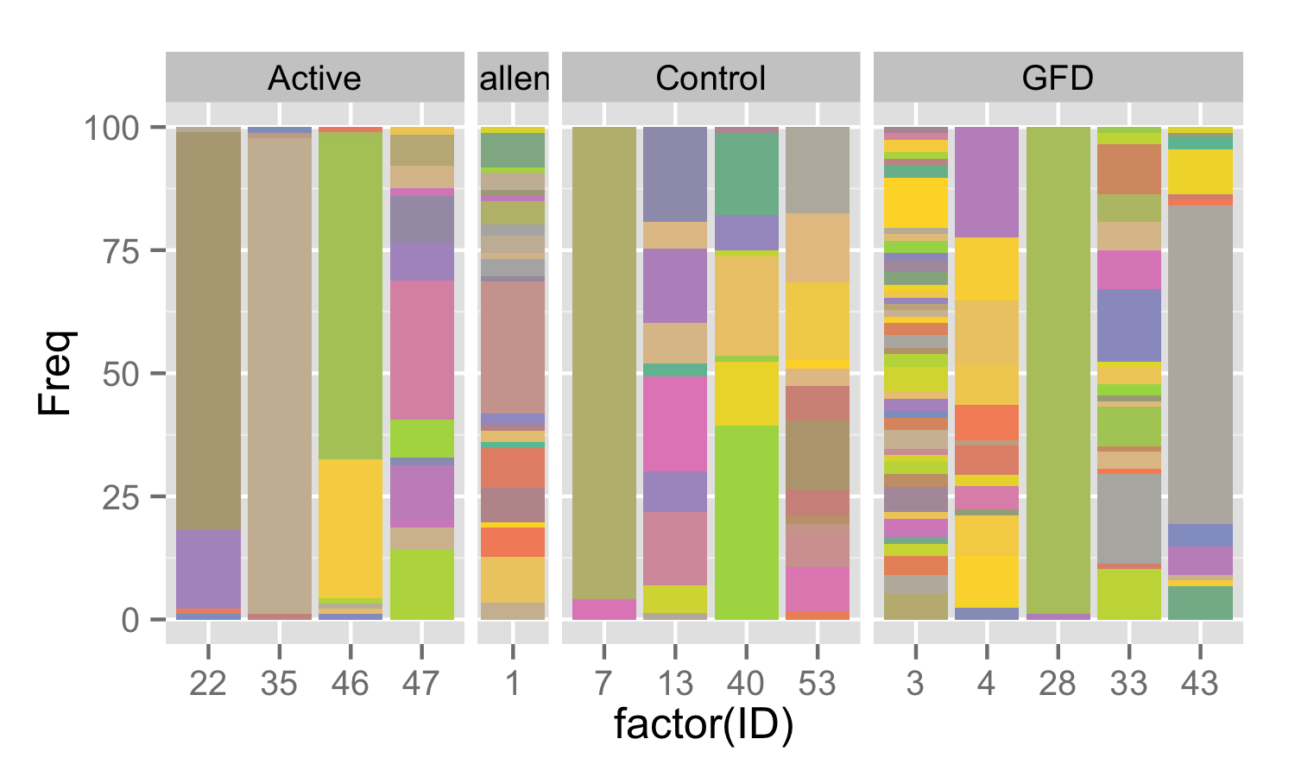
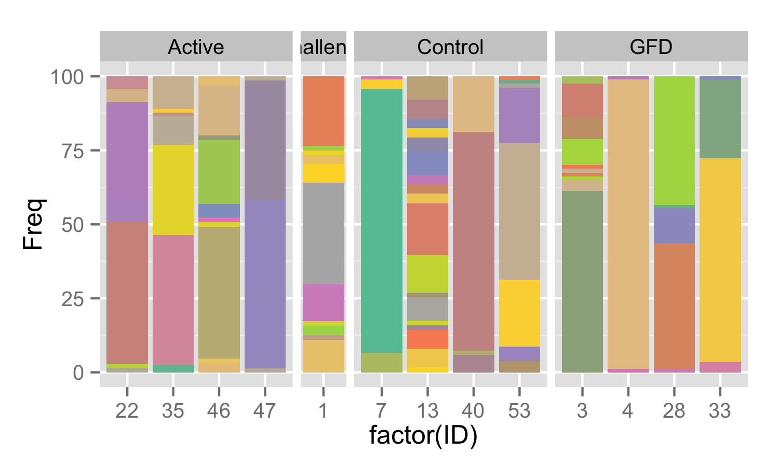
TRG clonal representation
IEL
PBL

Slide 5
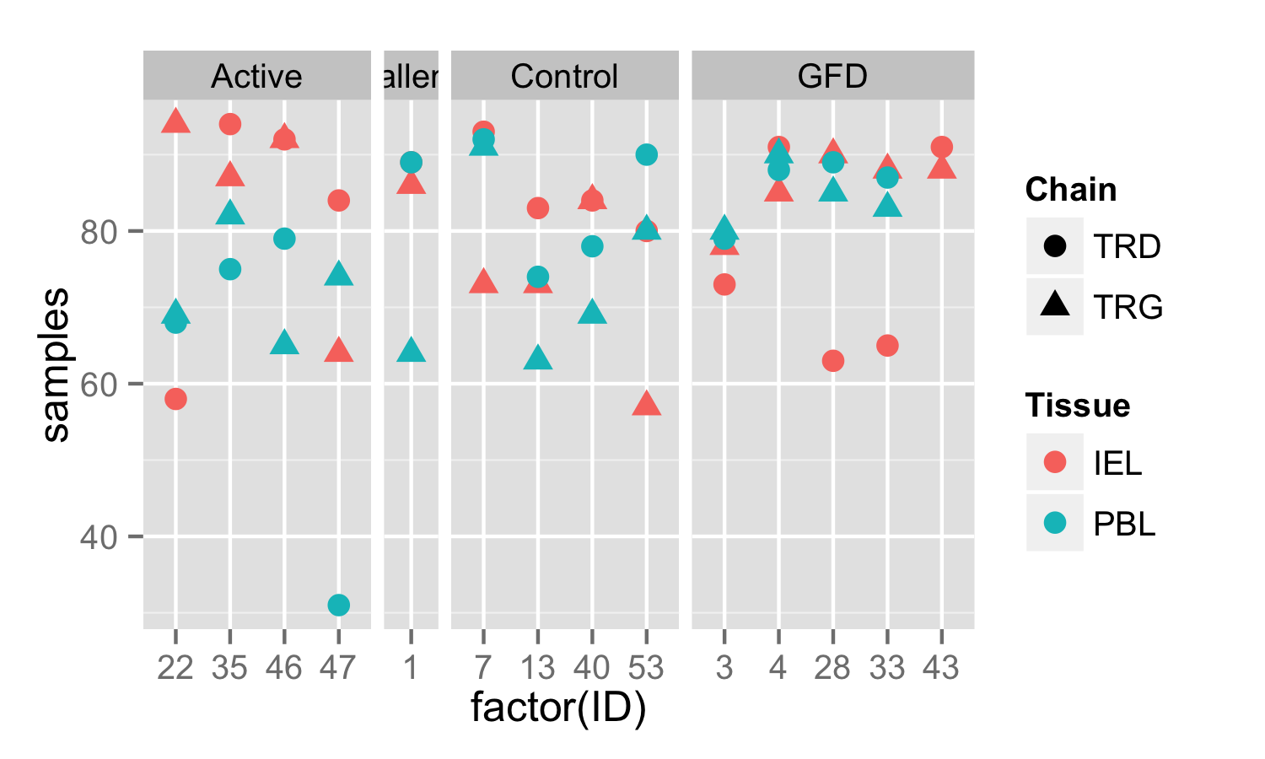
Diversity measurements accounting for sample sizes
I subsampled to 50 to normalize

Slide 6
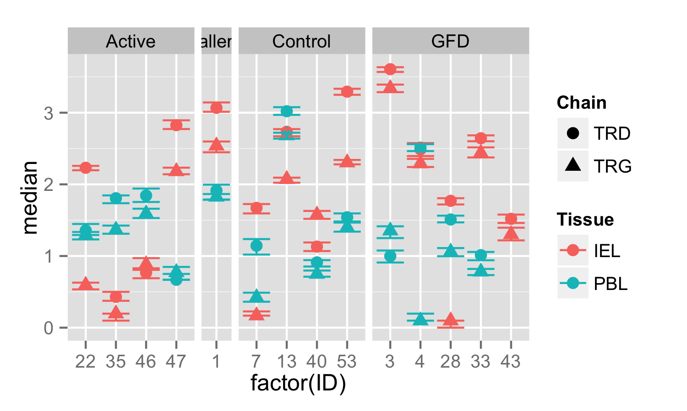
Subsampled Shannon Diversity
Error bars portray 25% and 75% quantiles

Slide 7
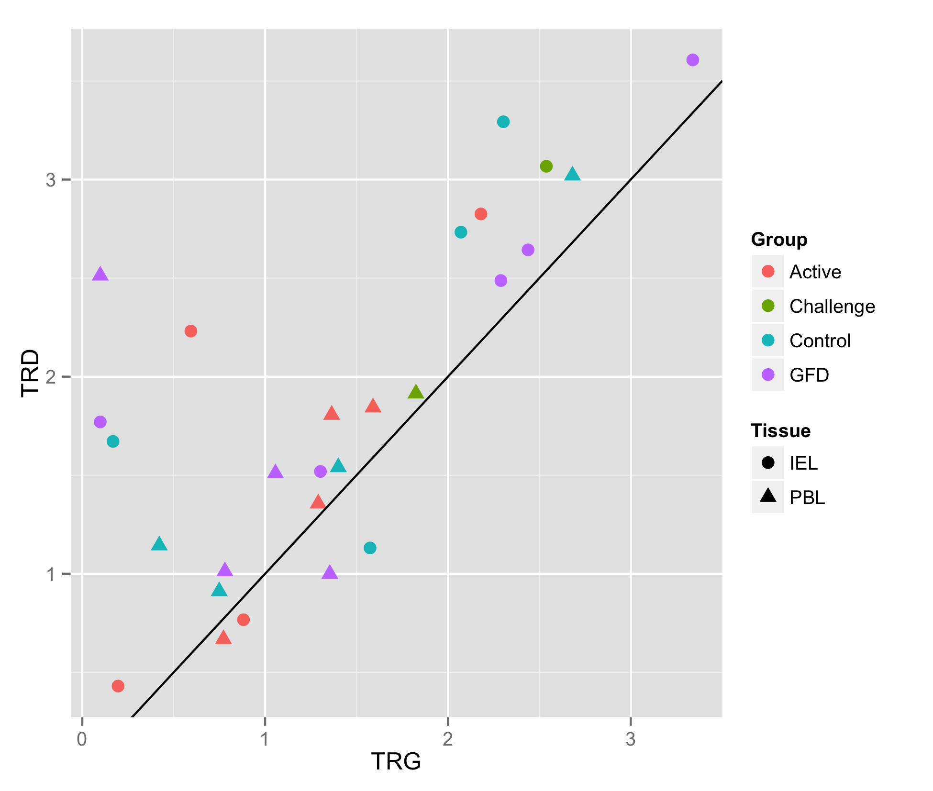
TRD chain tends to be more diverse than TRG chain per individual
Median subsampled Shannon diversity from each individual

Slide 8
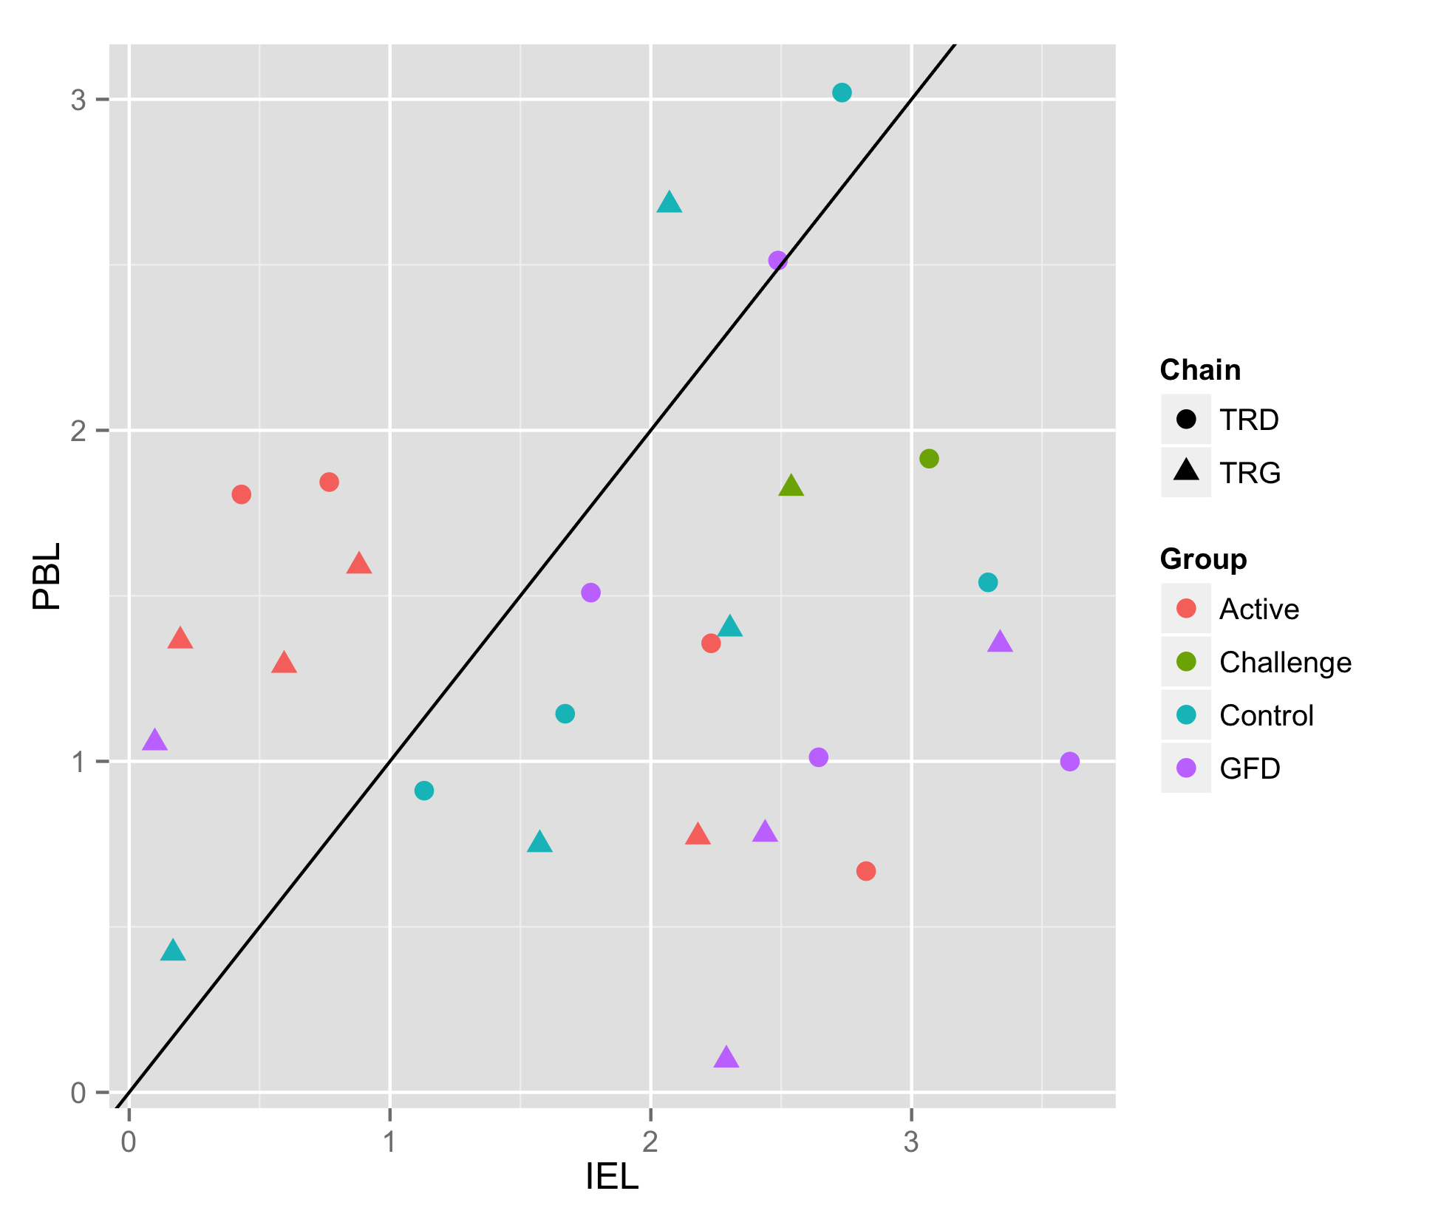
Active Group has relatively reduced IEL Diversity
Median subsampled Shannon diversity from each individual

Slide 9
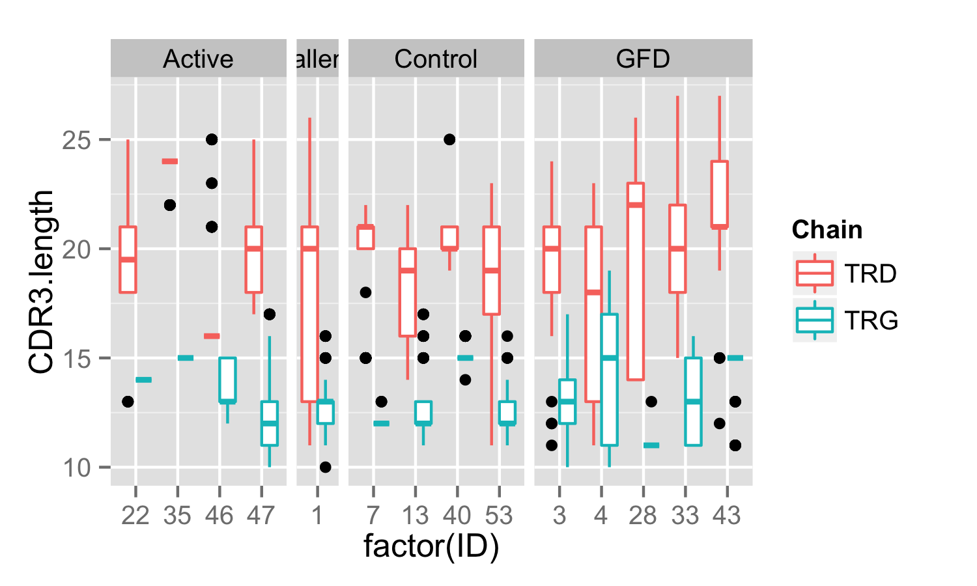
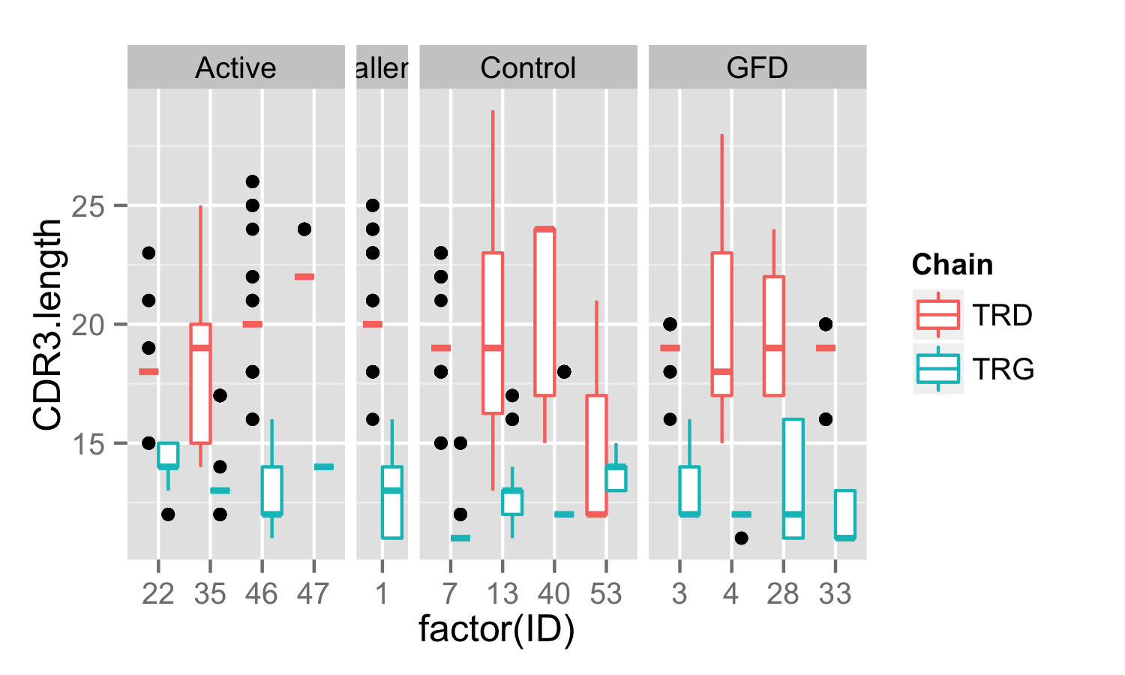
CDR3 Sequence Length
IEL
PBL

Slide 10
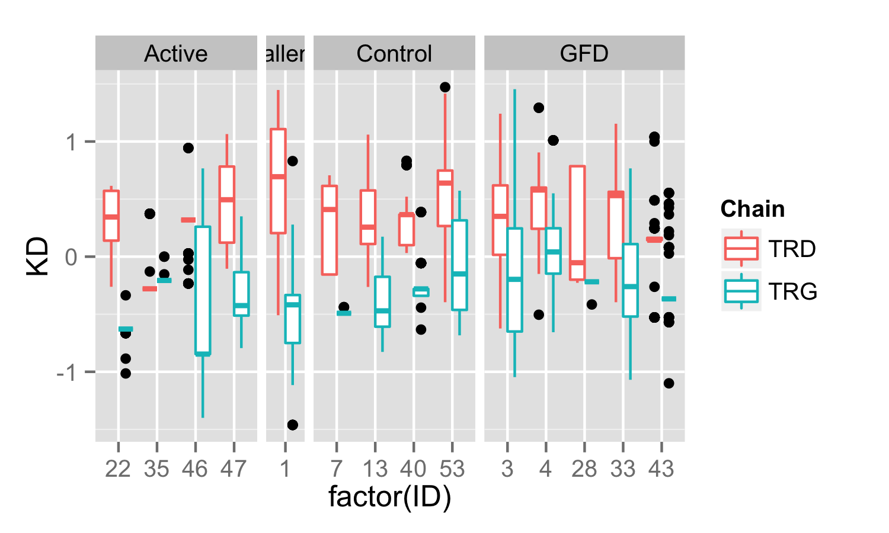
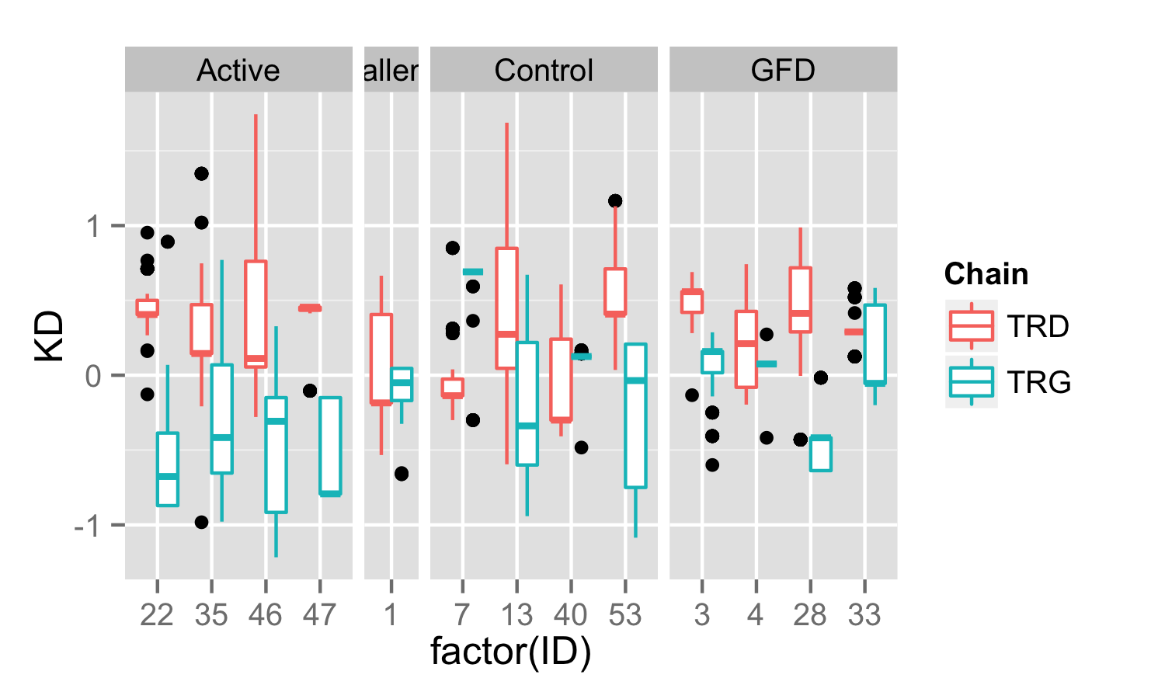
CDR3 Sequence Hydrophobicity (Kyte-Doolittle)
IEL
PBL
Average hydrophobicity per residue

Slide 11
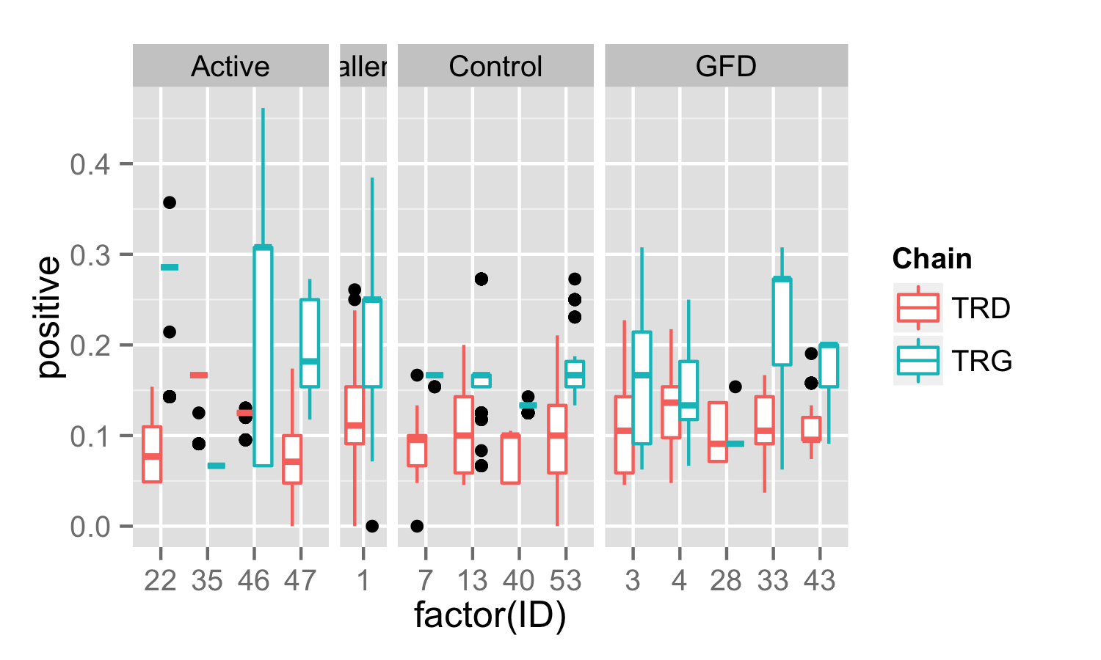
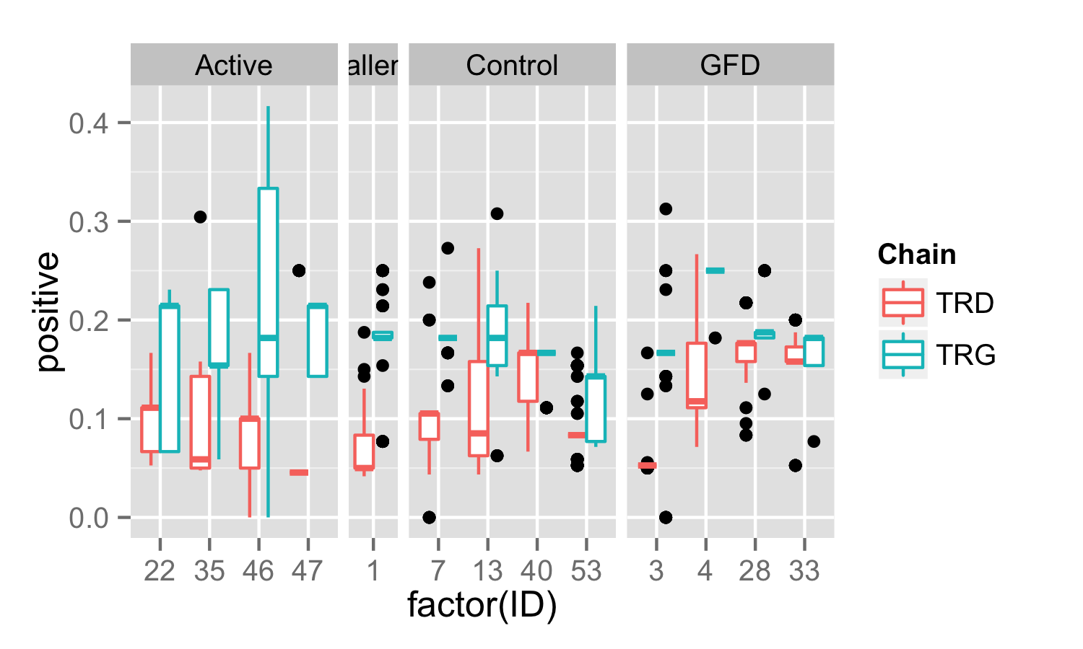
CDR3 Sequence Positive Charge (KRH)
IEL
PBL
Proportion of positively charged residues

Slide 12
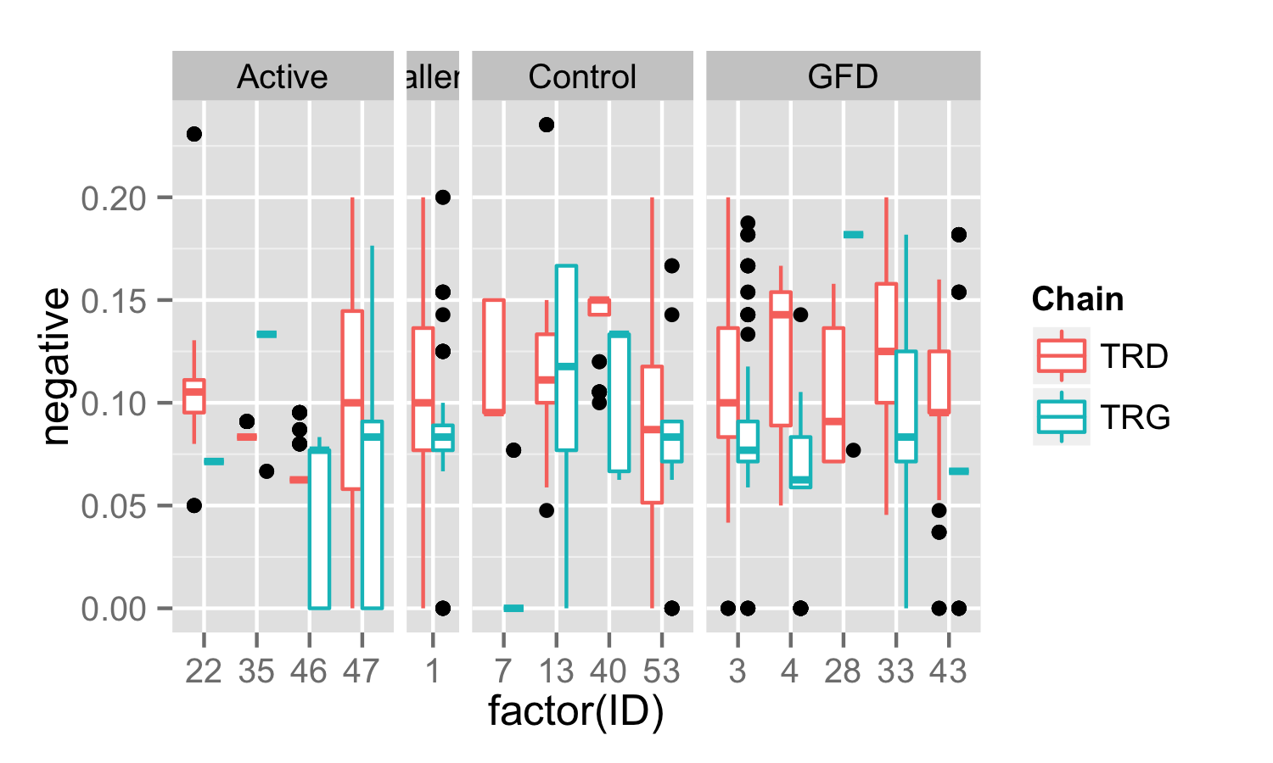
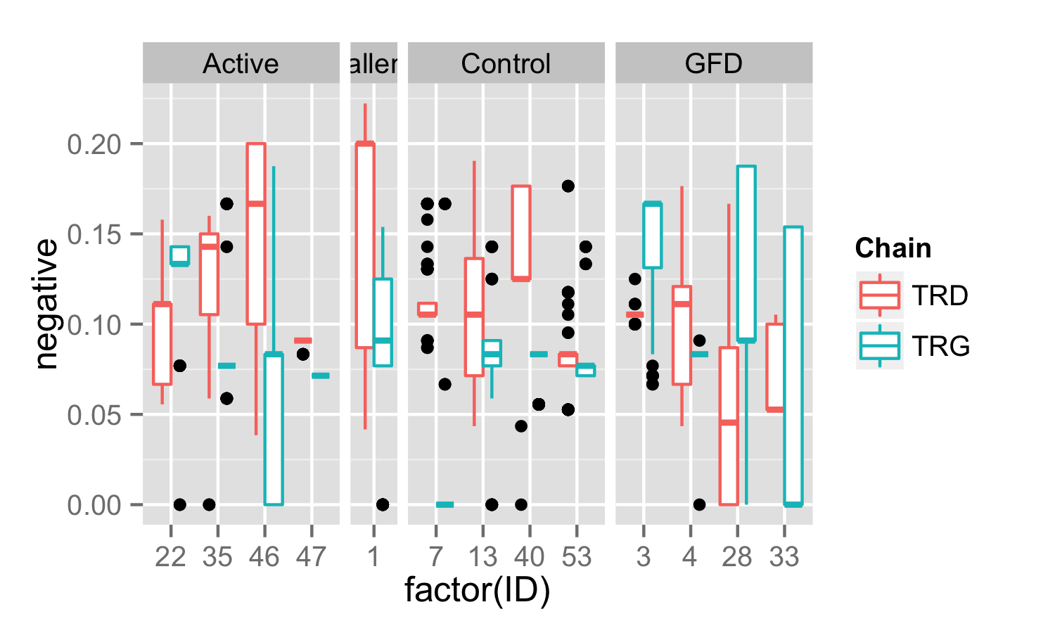
CDR3 Sequence Negative Charge (DE)
IEL
PBL
Proportion of negatively charged residues

Slide 13
Nearly all clones are unique between patients – however there are 4 exact matches
Group | ID | Tissue | Chain | TRV | CDR3 | TRJ | Freq | Count | NT
Active | 35 | IEL | TRD | 1 | CALGDQRVPIPWTGGYRHTDKLIF | 1 | 86.17 | 81 | 2
Active | 46 | PBL | TRD | 1 | CALGDQRVPIPWTGGYRHTDKLIF | 1 | 1.26 | 1 | 1
Challenge | 1 | IEL | TRD | 1 | CALGEYGRGSWGISHTDKLIF | 1 | 2.25 | 2 | 1
Challenge | 1 | PBL | TRD | 1 | CALGEYGRGSWGISHTDKLIF | 1 | 1.12 | 1 | 1
Active | 46 | PBL | TRG | 2 | CATWDGPNYYKKLF | 2 | 1.54 | 1 | 1
GFD | 3 | IEL | TRG | 2 | CATWDGPNYYKKLF | 2 | 5.13 | 4 | 1
Active | 46 | IEL | TRG | 9 | CALWEVLYKKLF | 1/2 | 1.08 | 1 | 1
GFD | 33 | IEL | TRG | 9 | CALWEVLYKKLF | 1/2 | 3.41 | 3 | 1

Slide 14
And 9 other pairs with matching CDR3 sequences
Group | ID | Tissue | Chain | TRV | CDR3 | TRJ | Freq | Count | NT
Challenge | 1 | IEL | TRG | 3 | CATWDRDSSDWIKTF | P2 | 1.16 | 1 | 1
Challenge | 1 | IEL | TRG | 5 | CATWDRDSSDWIKTF | P2 | 1.16 | 1 | 1
Challenge | 1 | IEL | TRG | 4 | CATWDGLYYKKLF | 1 | 3.49 | 3 | 1
GFD | 3 | IEL | TRG | 2 | CATWDGLYYKKLF | 1 | 2.56 | 2 | 1
Control | 13 | PBL | TRG | 2 | CATWDGYYKKLF | 1/2 | 7.94 | 5 | 2
GFD | 3 | IEL | TRG | 2 | CATWDGYYKKLF | 2 | 1.28 | 1 | 1
GFD | 3 | IEL | TRG | 9 | CALWEVDYKKLF | 1 | 5.13 | 4 | 1
GFD | 3 | PBL | TRG | 9 | CALWEVDYKKLF | 1/2 | 61.25 | 49 | 1

Slide 15
Group | ID | Tissue | Chain | TRV | CDR3 | TRJ | Freq | Count | NT
Active | 22 | PBL | TRG | 9 | CALWEVHYYKKLF | 1/2 | 7.25 | 5 | 1
GFD | 3 | PBL | TRG | 9 | CALWEVHYYKKLF | 2 | 1.25 | 1 | 1
GFD | 3 | IEL | TRG | 8 | CATWVYYKKLF | 1 | 1.28 | 1 | 1
GFD | 4 | IEL | TRG | 5 | CATWVYYKKLF | 1 | 11.76 | 10 | 1
GFD | 3 | IEL | TRG | 9 | CALWEVRYKKLF | 1 | 2.56 | 2 | 1
GFD | 4 | PBL | TRG | 9 | CALWEVRYKKLF | 1/2 | 97.78 | 88 | 3
GFD | 4 | PBL | TRG | 8 | CATWDYYKKLF | 1/2 | 1.11 | 1 | 1
GFD | 28 | PBL | TRG | 4 | CATWDYYKKLF | 1/2 | 43.53 | 37 | 1
GFD | 3 | IEL | TRG | 3 | CATWDRPEKLF | 1/2 | 2.56 | 2 | 1
GFD | 33 | IEL | TRG | 3 | CATWDRPEKLF | 1 | 3.41 | 3 | 1

Slide 16
Multiple Sequence Alignment – different results from different algorithms
Muscle
TCoffee
ClustalW
Probcons
ClustalOmega
MSAprobs
GLprobs
Active TRD CDR3 Sequences

Slide 17
MSA (Muscle) of CDR3 sequences by chain and tissue
TRD IEL
TRG IEL
TRD PBL
TRG PBL

Slide 18
MSA (Muscle) of TRD IEL CDR3 sequences by patient group
Active
Control
Challenge
GFD

Slide 19
MSA (Muscle) of TRG IEL CDR3 sequences by patient group
Active
Control
Challenge
GFD

Slide 20
MSA (Muscle) of TRD PBL CDR3 sequences by patient group
Active
Control
Challenge
GFD

Slide 21
MSA (Muscle) of TRG PBL CDR3 sequences by patient group
Active
Control
Challenge
GFD

Slide 22
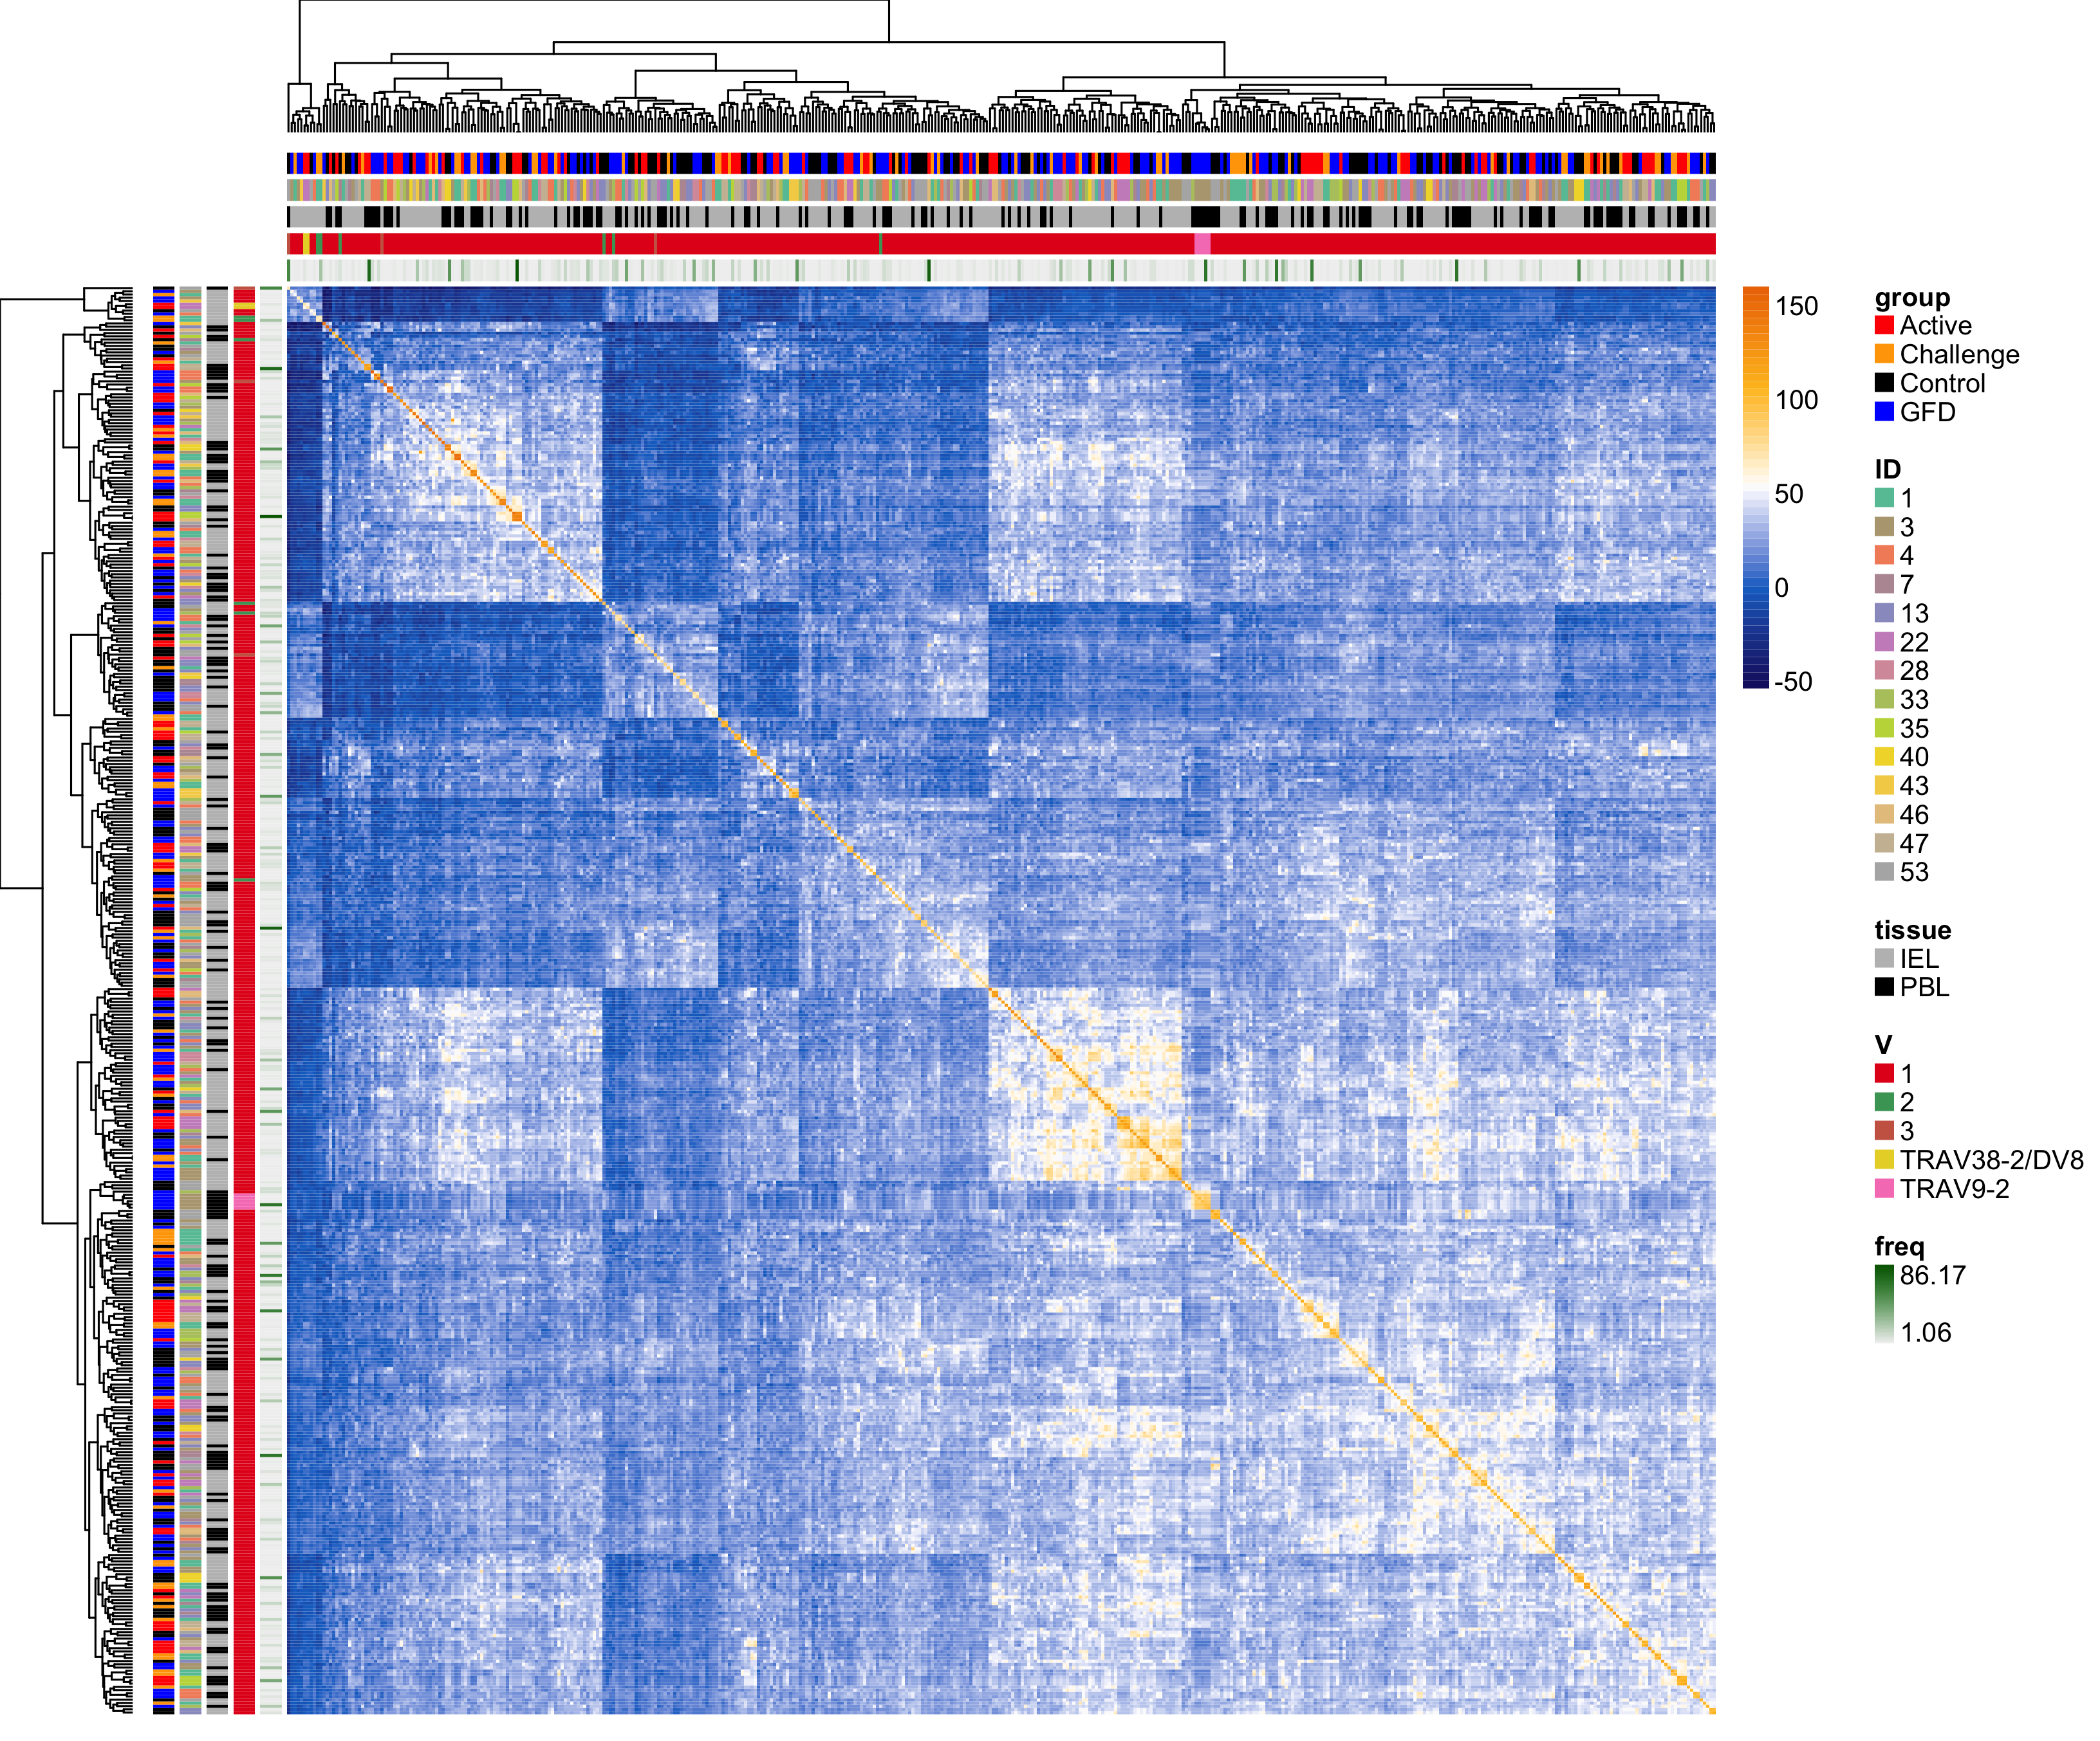
Pairwise CDR3 Sequence Similarity (BLOSUM62)
TRD

Slide 23
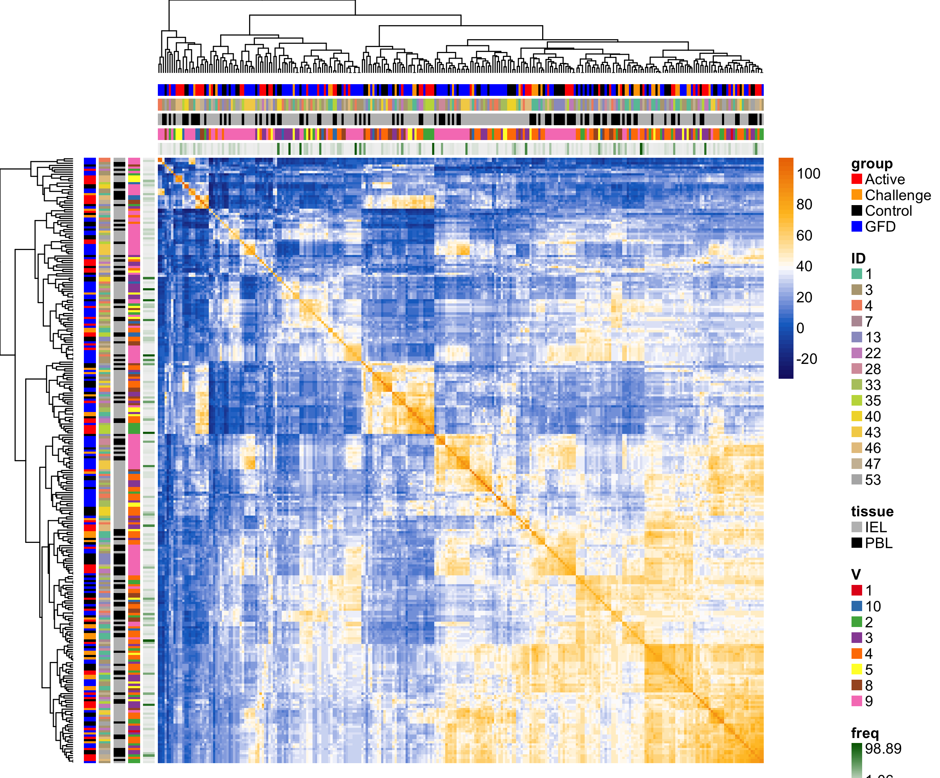
Pairwise CDR3 Sequence Similarity (BLOSUM62)
TRG

Slide 24
Cluster A
TRD
Cluster B
A
B
Cluster C
C

Slide 25
Cluster A
Cluster B
TRG
A
Cluster C
B
C
Cluster D
D

